Slide 1
THEME: DEFINITION
Theme can be defined as:
The life lesson or moral of a story
The author’s advice to the reader
A universal truth or message about life

Slide 2
TOPIC VS. THEME
A theme MUST be:
Written in your own words.
A complete sentence
Something true about people or life in general
Does not include a characters name

Slide 3
TOPIC VS. THEME
Topics are only one or two words long.

Slide 4
TOPICS VS. THEMES
TOPIC
THEME
Love
Trust
Adventure
Falling in love is often easy, but staying in love can require a lot of work.
Without trust, even the best relationships can fall apart.
Even though new adventures can seem scary at first, they can be life changing experiences.

Slide 5
TOPICS VERSUS THEMES
A TOPIC of
The Pursuit of Happyness is
“hard work"
A THEME might be “Hard work is almost always worth it in the end.”

Slide 6
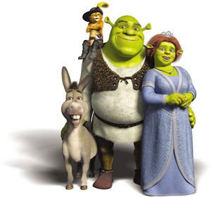
TOPICS VERSUS THEMES
A TOPIC of Shrek is “beauty.”
A THEME might be “Who we are on the inside is much more valuable than what we are on the outside.”

Slide 7
TOPICS VERSUS THEMES
A TOPIC of Love and Basketball is “communication.”
A THEME might be “Being open and honest is difficult sometimes, but it is the best way to maintain good relationships.”

Slide 8
TOPICS VERSUS THEME STATIONS
CORRUPTION, POWER, INTELLIGENCE, FAILURE TO ACT, EXPLOTATION, HOPES AND DREAMS, RULES AND ORDER, FOOLISHNESS, PRIDE, RELIGION
Each station is organized with a different topic. As a group, you will rotate and write down one theme from each topic station. You will provide a detail from the story to support your claim. Do not move until the timers goes off. You will go to four of the five stations.

