Slide 1
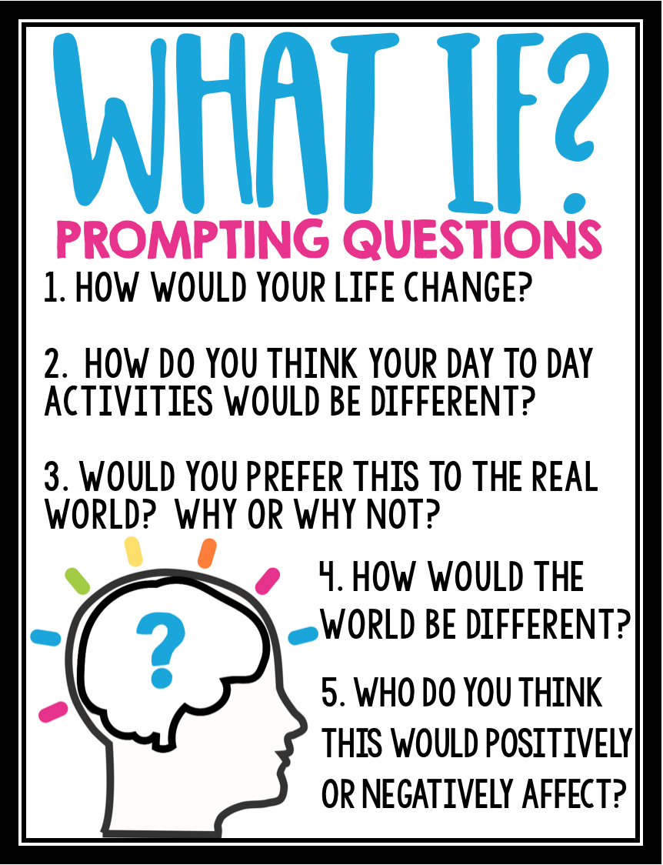
What if there were no laws?
© Presto Plans

Slide 2
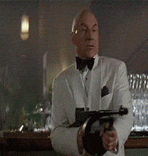
QUickwrite
1. What thoughts would go through someone’s mind right before they die? Write down what you think that people would imagine if they knew they would die soon.
Write at least 5 sentences for full credit ☺

Slide 3
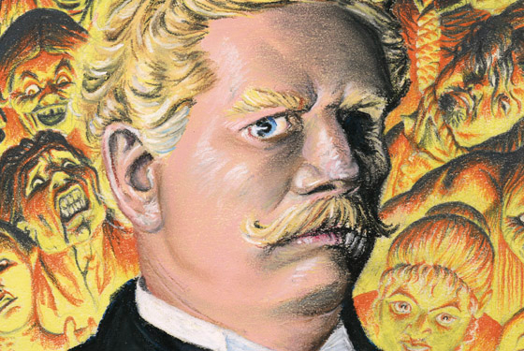
Ambrose Bierce
2. With your groups, read through the article about Ambrose Bierce. Then, underneath your quickwrite, respond to the following prompt in 3-4 sentences:
Using your knowledge about Bierce, make a prediction – what do you think “An Occurrence at Owl Creek Bridge” will be about? What kind of topics and themes do you think it might deal with?

Slide 4
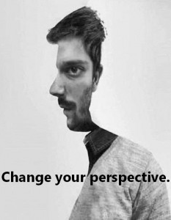
Point of View
In the different sections of Bierce’s story, watch for these variations in point of view:
Omniscient, in which the narrator seems to know everything about all the characters and events
Objective, in which the narrator reports without comment, describing things in a detached way (like a camera recording a scene)
Third-Person-Limited, in which the narrator zooms in on the thoughts or feelings of a single character.

Slide 5
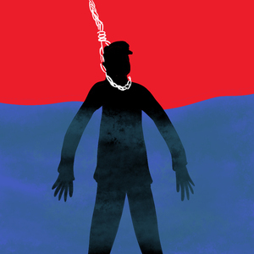
“An Occurrence at Owl Creek Bridge”
As you read independently or with your groups, complete the following on your paper:
3a-c. Identify at least three times where the narrator shifts the point of view. For each moment, write down the page number, the type of perspective (omniscient, objective, or third-person-limited), and two quotes: one from before and one from after the perspective change that supports your finding.

Slide 6
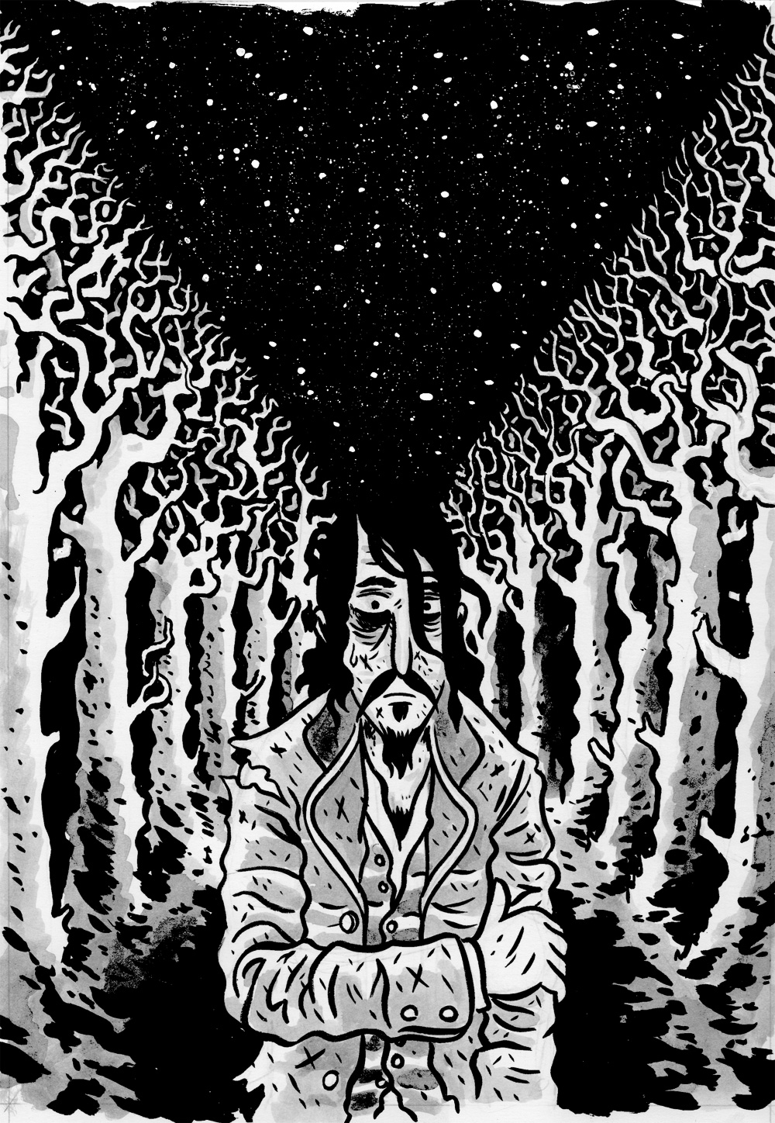
“An Occurrence at Owl Creek Bridge”
After you read, respond to the following questions:
4. Now that you’ve identified several shifts in perspective throughout Bierce’s story, discuss one of them in-depth with your group. Choose one of the shifts you found and analyze why Bierce chose to change the point of view at that moment in his story. What effect does the shift have on the reader? Use textual evidence to support your response.
5. How would the ending of the story have changed if a Romantic author had written it? Explain your reasoning.

