Slide 1
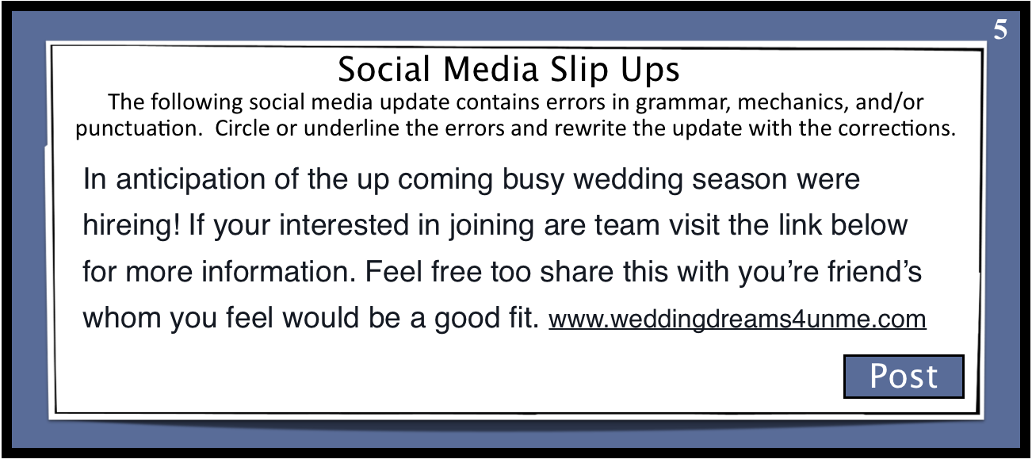
Do Now: Social Media Edit
Correct the spelling, punctuation, and grammar errors in the following social media post.
What’s on your mind?
© Presto Plans

Slide 2
upcoming: Upcoming was misspelled.
season, we’re hiring: Commas are used to separate introductory elements from the rest of the sentence. We’re is a contraction for we are. Were is the past tense of the verb to be. Hiring was also misspelled.
you’re - You’re is a contraction of you are. Your is the possessive form.
our team, visit: Are is a form of the verb to be. Our indicates possession.
to: Too is a synonym for also or means an excess of something. To should be used here as a preposition.
your friends who: You’re is a contraction of you are. Your is the possessive form. Friends indicates more than one friend. Who is used to refer to the subject of the sentence (friends) . Whom refers only to the object of the sentence.
© Presto Plans

Slide 6
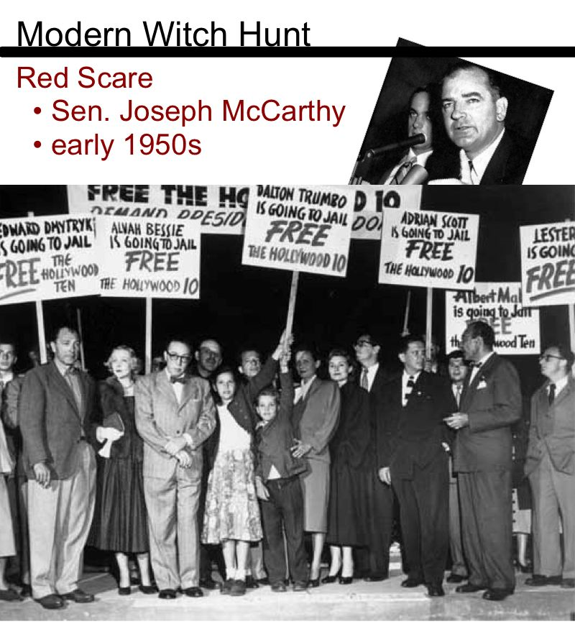

Slide 10
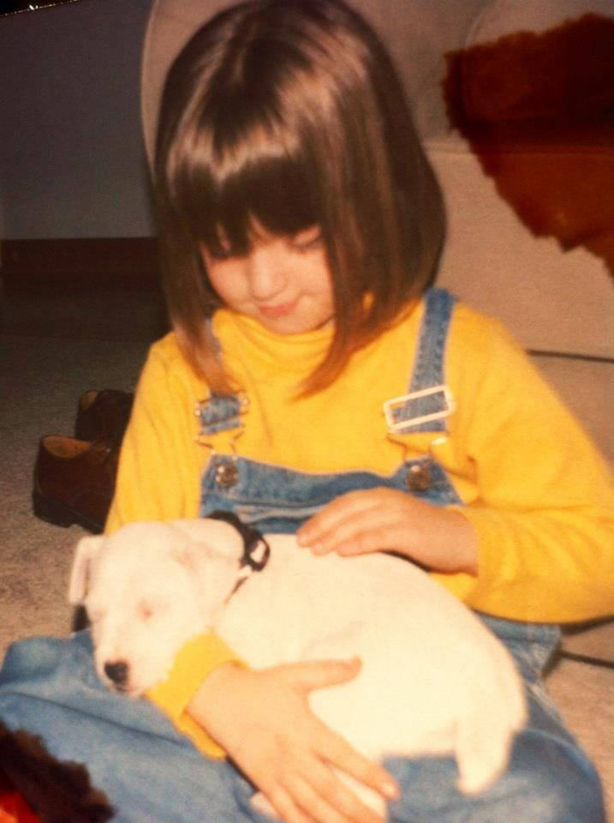
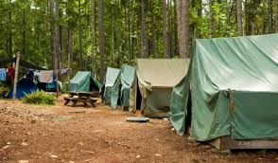
Tablerock Lake, 2000
Ms. Lane = Eight years old
Scary shadow of a man at camp!

Slide 11
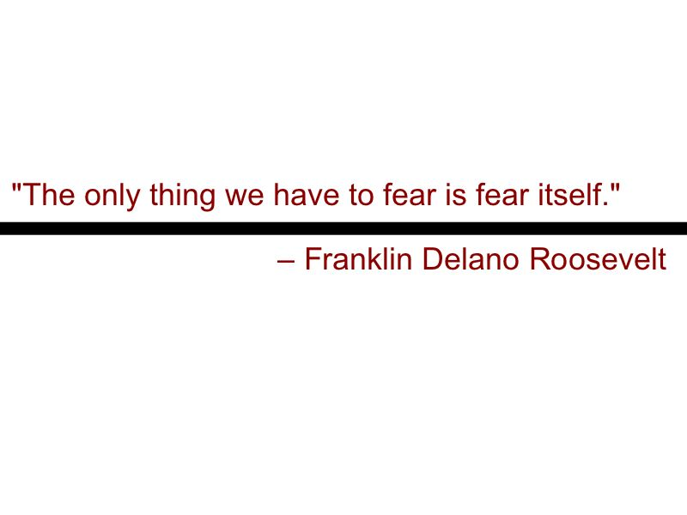

Slide 12
Modern Witch Hunt Story
Your story must:
demonstrate your understanding of how modern witch hunts begin and are fueled (fear ≠ logic/reason)
be believable
follow the story-telling arc pattern (exposition, conflict introduction, rising action, climax, falling action, resolution)
be at least 1,000 typed words (about 2 pages)
show good command of mechanics, word usage, and grammar
You will be given several days in class to work on your short story, but extra time outside of class will be needed. Plan accordingly.
Final draft due Tuesday, 9/19 at the end of class
Assignment:
Choose one of the story seeds on the handout and use it as inspiration for a short story in which you show how the characters in the scenario are swept away by mass hysteria in a modern-day witch hunt.
Your story must have a compelling introduction and follow the story-telling arc format explained in class.

Slide 13
Storytelling Arc Lecture
Let’s talk about how your story should be structured!
Get out the sheet that says “Breaking Down the Short Story Steps” and prepare to take some notes.
Lecture Link:
https://prezi.com/deznxfa1txfr/storytelling-arc/

Slide 14
Modern Witch Hunt Story
Grab a Chromebook, create a Google Doc, share it with me, and begin!
Your story must:
demonstrate your understanding of how modern witch hunts begin and are fueled (fear ≠ logic/reason)
be believable
follow the story-telling arc pattern (exposition, conflict introduction, rising action, climax, falling action, resolution)
be at least 1,000 typed words (about 2 pages)
show good command of mechanics, word usage, and grammar
You will be given several days in class to work on your short story, but extra time outside of class will be needed. Plan accordingly.
Final draft due Tuesday, 9/19
Assignment:
Choose one of the story seeds on the handout and use it as inspiration for a short story in which you show how the characters in the scenario are swept away by mass hysteria in a modern-day witch hunt.
Your story must have a compelling introduction and follow the story-telling arc format explained in class.

