Slide 1
“I Have A dream”
English 10

Slide 2
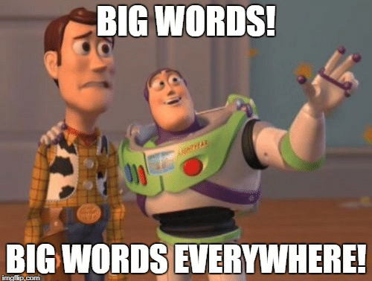
Do Now: New Vocabulary!
Directions: Use learnersdictionary.com to define the following words.
Words must be in a complete sentence and have one synonym and one antonym.
If you need help with what definition to write, please ask me!

Slide 3
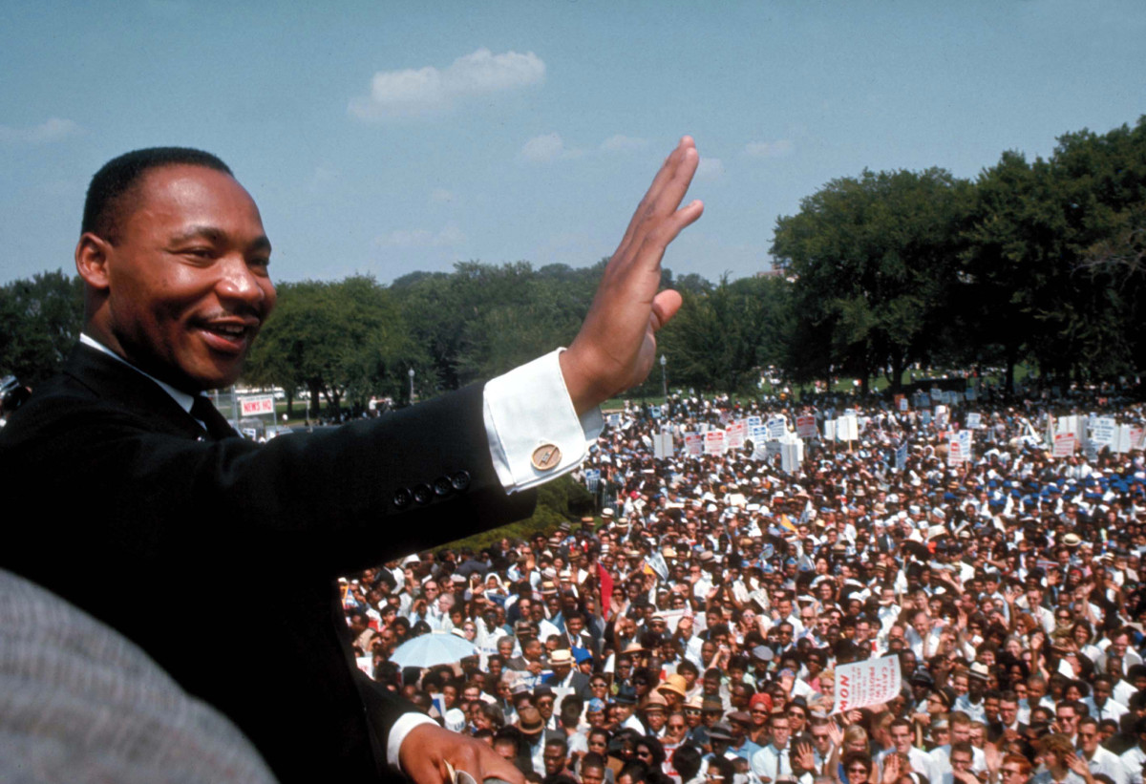
“I Have a Dream” Dr. Martin Luther King, Jr.
Directions: Listen to the audio of King’s famous speech, “I Have a Dream”. Feel free to take notes on a separate sheet of paper. After listening to the audio clip, answer the following questions.

